Slide 1
Organizational Behaviour
VITBS
VIT Bhopal

Slide 2
What Is Organizational Behavior?

Slide 3
After studying this chapter, you should
be able to:
Describe what managers do
Define organizational behavior (OB)
Explain the value of the systematic study of OB
Identify the contributions made by major behavioral science disciplines to OB
List the major challenges and opportunities for managers to use OB concepts
L E A R N I N G O B J E C T I V E S

Slide 4
What Managers Do
Managers (or Administrators)
Individuals who achieve goals through other people
Managerial Activities
Make decisions
Allocate resources
Direct activities of others to attain goals

Slide 5
Where Managers Work
Organization
A consciously coordinated social unit, composed of two or more people, that functions on a relatively continuous basis to achieve a common goal or set of goals

Slide 6
Management Functions
Planning
Organizing
Management Functions
Controlling
Leading

Slide 7
Management Functions (cont’d)
Planning
A process that includes defining goals, establishing strategy, and developing plans to coordinate activities

Slide 8
Management Functions (cont’d)
Organizing
Determining what tasks are to be done, who is to do them, how the tasks are to be grouped, who reports to whom, and where decisions are to be made

Slide 9
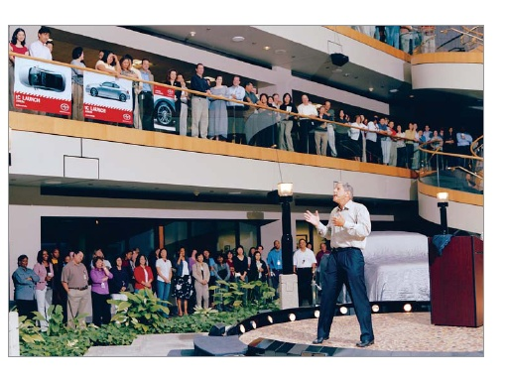
Management Functions (cont’d)
Leading
A function that includes motivating employees, directing others, selecting the most effective communication channels, and resolving conflicts

Slide 10
Management Functions (cont’d)
Controlling
Monitoring activities to ensure they are being accomplished as planned and correcting any significant deviations

Slide 11
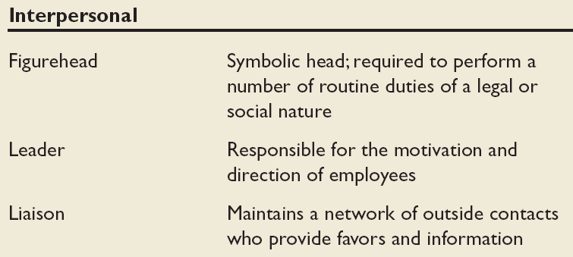
Mintzberg’s Managerial Roles
Source: Adapted from The Nature of Managerial Work by H. Mintzberg. Copyright © 1973 by H. Mintzberg. Reprinted by permission of Pearson Education.

Slide 12
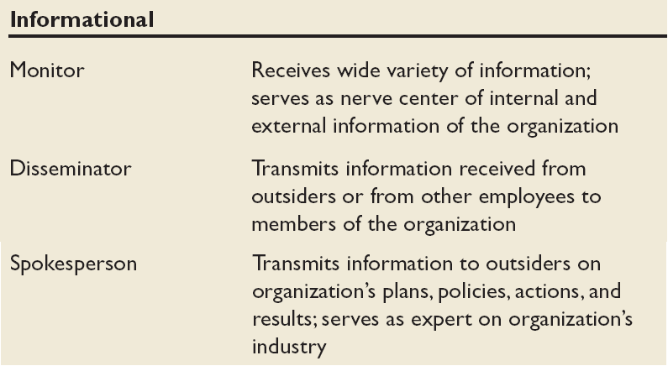
Mintzberg’s Managerial Roles (cont’d)
Source: Adapted from The Nature of Managerial Work by H. Mintzberg. Copyright © 1973 by H. Mintzberg. Reprinted by permission of Pearson Education.

Slide 13
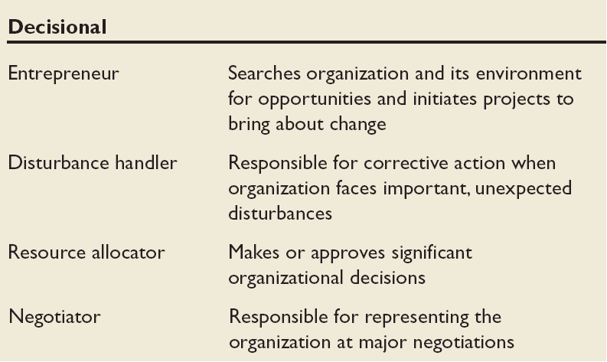
Mintzberg’s Managerial Roles (cont’d)
Source: Adapted from The Nature of Managerial Work by H. Mintzberg. Copyright © 1973 by H. Mintzberg. Reprinted by permission of Pearson Education.

Slide 14
Management Skills
Technical Skills
The ability to apply specialized knowledge or expertise
Human Skills
The ability to work with, understand, and motivate other people, both individually and in groups
Conceptual Skills
The mental ability to analyze and diagnose complex situations

Slide 15
Effective Versus Successful Managerial Activities (Luthans)
Traditional Management
Decision making, planning, and controlling
Communication
Exchanging routine information and processing paperwork
Human Resource Management
Motivating, disciplining, managing conflict, staffing, and training
Networking
Socializing, politicking, and interacting with others

Slide 16
Allocation of Activities by Time

Slide 17
Organizational Behavior
Organizational Behavior (OB)
A field of study that investigates the impact that individuals, groups, and structure have on behavior within organizations, for the purpose of applying such knowledge toward improving an organization’s effectiveness

Slide 18
Complementing Intuition with Systematic Study
Intuition
“Gut” feelings about “why I do what I do” and “what makes others tick”
Systematic Study
Looking at relationships, attempting to attribute causes and effects, and drawing conclusions based on scientific evidence
Provides a means to predict behaviors

Slide 20
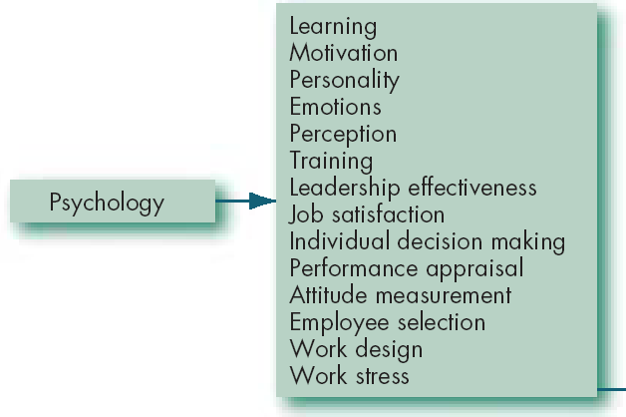
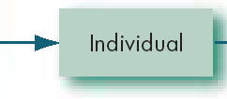
Contributing Disciplines to the OB Field
Psychology
The science that seeks to measure, explain, and sometimes change the behavior of humans and other animals

Slide 21
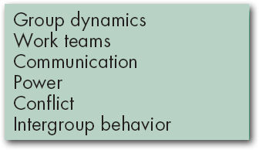


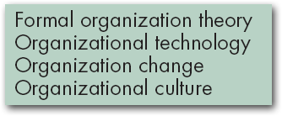

Contributing Disciplines to the OB Field (cont’d)
Sociology
The study of people in relation to their fellow human beings

Slide 22
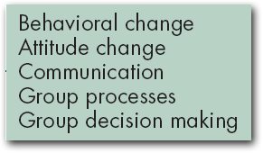

Contributing Disciplines to the OB Field (cont’d)
Social Psychology
An area within psychology that blends concepts from psychology and sociology and that focuses on the influence of people on one another

Slide 23
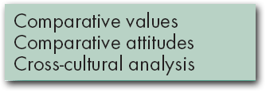


Contributing Disciplines to the OB Field (cont’d)
Anthropology
The study of societies to learn about human beings and their activities

Slide 24
Contingency variables: “It Depends!”
Situational factors that make the main relationship between two variables change—e.g., the relationship may hold for one condition but not another
x
y
In
May be related to
Country 1
x
y
In
Country 2
May NOT be related to

Slide 25
Major Workforce Diversity Categories
Gender
National Origin
Disability
Age
Religion
Race
Domestic Partners

Slide 26
Challenges and Opportunities for OB
Responding to Globalization
Increased foreign assignments
Working with people from different cultures
Coping with anti-capitalism backlash
Overseeing movement of jobs to countries with low-cost labor
Managing people during the war on terror
Managing Workforce Diversity
Embracing diversity
Changing U.S. demographics
Implications for managers
Recognizing and responding to differences

Slide 27
Challenges and Opportunities for OB (cont’d)
Improving Quality and Productivity
Quality management (QM)
Process reengineering
Responding to the Labor Shortage
Changing work force demographics
Fewer skilled laborers
Early retirements and older workers
Improving Customer Service
Increased expectation of service quality
Customer-responsive cultures

Slide 28
Challenges and Opportunity for OB (cont’d)
Improving people skills
Empowering people
Stimulating innovation and change
Coping with “temporariness”
Working in networked organizations
Helping employees balance work/life conflicts
Improving ethical behavior
Managing people during the war on terrorism

Slide 29
What Is Quality Management?
Intense focus on the customer
Concern for continuous improvement
Improvement in the quality of everything the organization does
Accurate measurement
Empowerment of employees

Slide 30
A Downside to Empowerment?

Slide 31
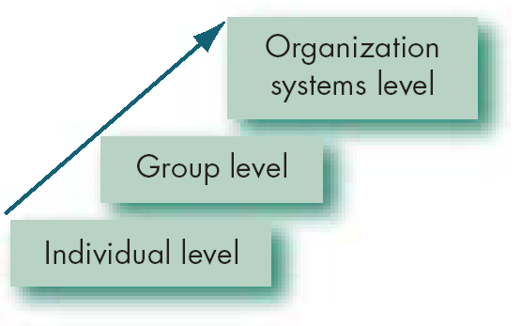
Basic OB Model, Stage I
Model
An abstraction of reality
A simplified representation of some real-world phenomenon

Slide 32
The Dependent Variables
Dependent Variable
A response that is affected by an independent variable (what organizational behavior researchers try to understand)
y
x

Slide 33
The Dependent Variables (cont’d)
Productivity
A performance measure that includes effectiveness and efficiency
Effectiveness
Achievement of goals
Efficiency
Meeting goals at a low cost

Slide 34
The Dependent Variables (cont’d)
Absenteeism
The failure to report to work
Turnover
The voluntary and involuntary permanent withdrawal from an organization

Slide 35
The Dependent Variables (cont’d)
Deviant Workplace Behavior
Voluntary behavior that violates significant organizational norms and thereby threatens the well-being of the organization and/or any of its members

Slide 36
The Dependent Variables (cont’d)
Organizational Citizenship Behavior (OCB)
Discretionary behavior that is not part of an employee’s formal job requirements, but that nevertheless promotes the effective functioning of the organization

Slide 37
The Dependent Variables (cont’d)
Job Satisfaction
A general attitude (not a behavior) toward one’s job; a positive feeling of one's job resulting from an evaluation of its characteristics

Slide 38
The Independent Variables
Independent Variable
The presumed cause of some change in the dependent variable; major determinants of a dependent variable
Independent Variables Can Be
Individual-Level Variables
Group-Level Variables
Organization System-Level Variables

Slide 39
Basic OB Model, Stage II

Slide 40
THANK YOU

